Slide 1
Border Crossing Entry Data
Ander Eguiluz

Slide 2
Statistical Question
Is there a significant difference in the number of border crossings between different states or borders?

Slide 3
Variables Used & Description
Port Name: The name of the port where the border crossing occurred.
State: The state in which the port is located.
Border: Indicates whether the border crossing is between the US and Mexico or between the US and Canada.
Date: The date on which the border crossing occurred.
Measure: The type of border crossing measure, such as the mode of transportation (e.g., Buses, Trucks, Pedestrians) or the purpose of crossing (e.g., Personal Vehicles, Truck Containers Loaded).
Value: The number of border crossings for the specified measure on the given date at the specified port.

Slide 4
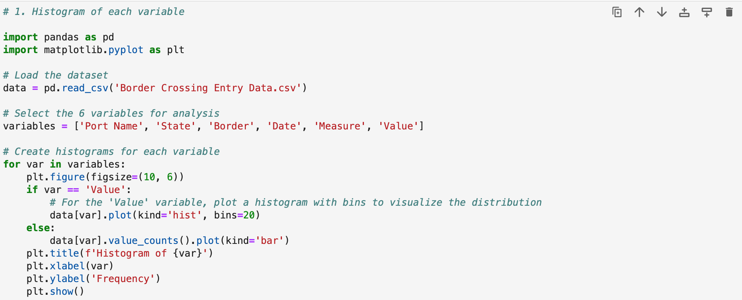
Code to Obtain Histograms of Variables

Slide 5
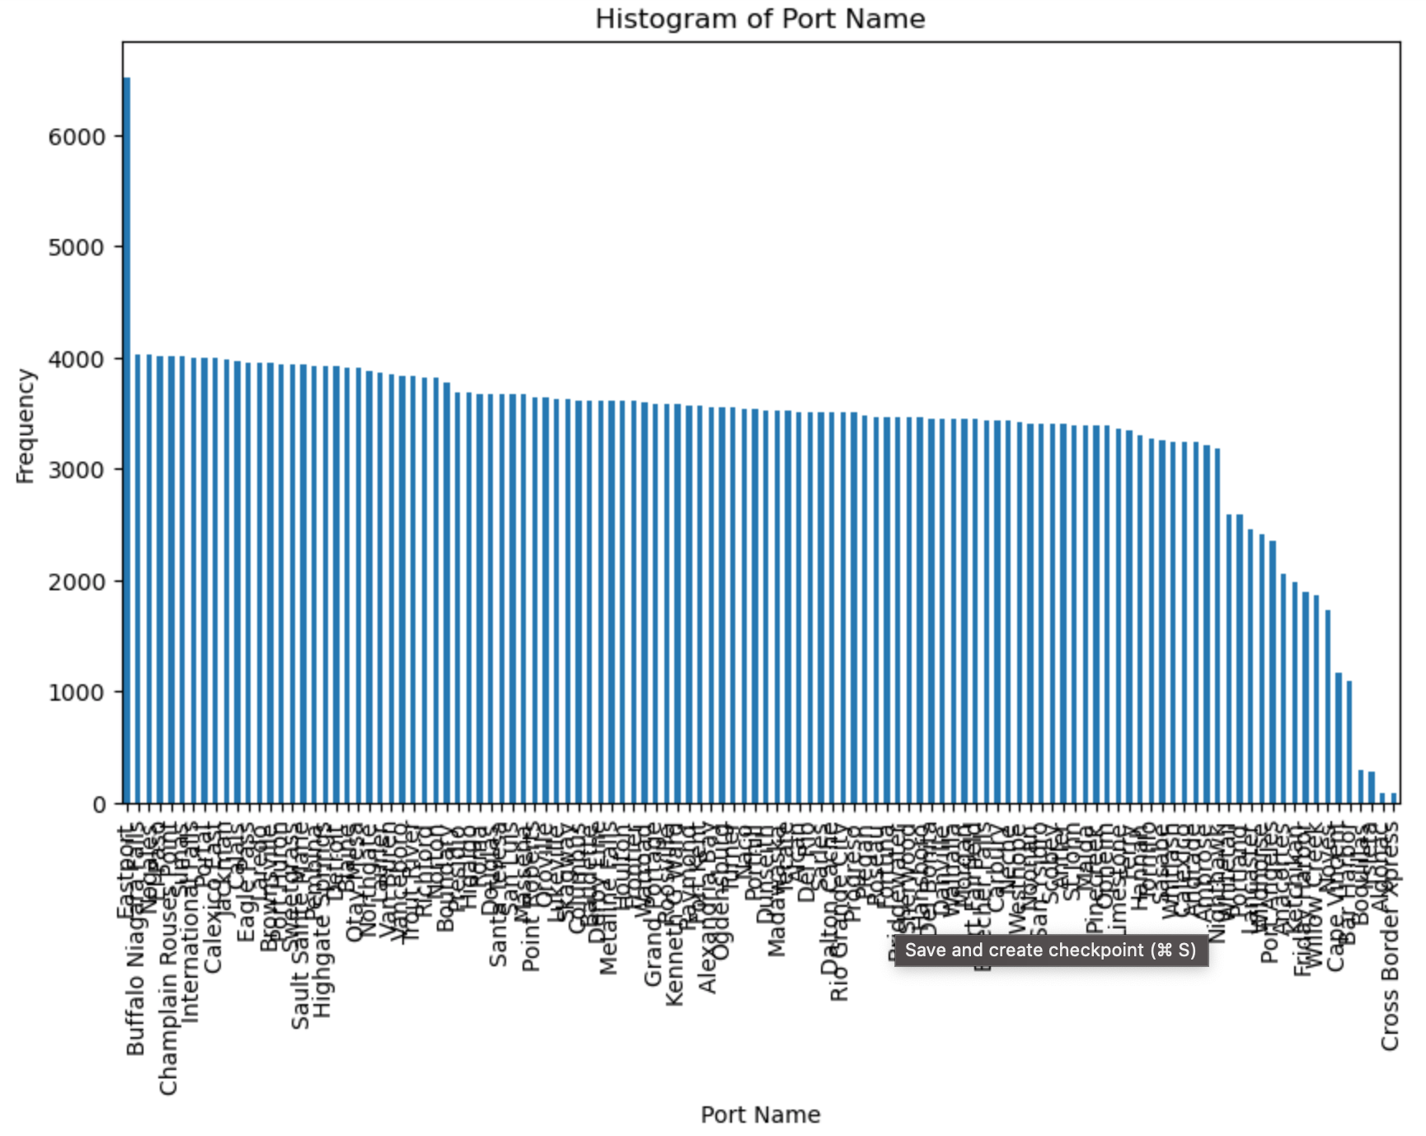
Histogram of Port Name

Slide 6
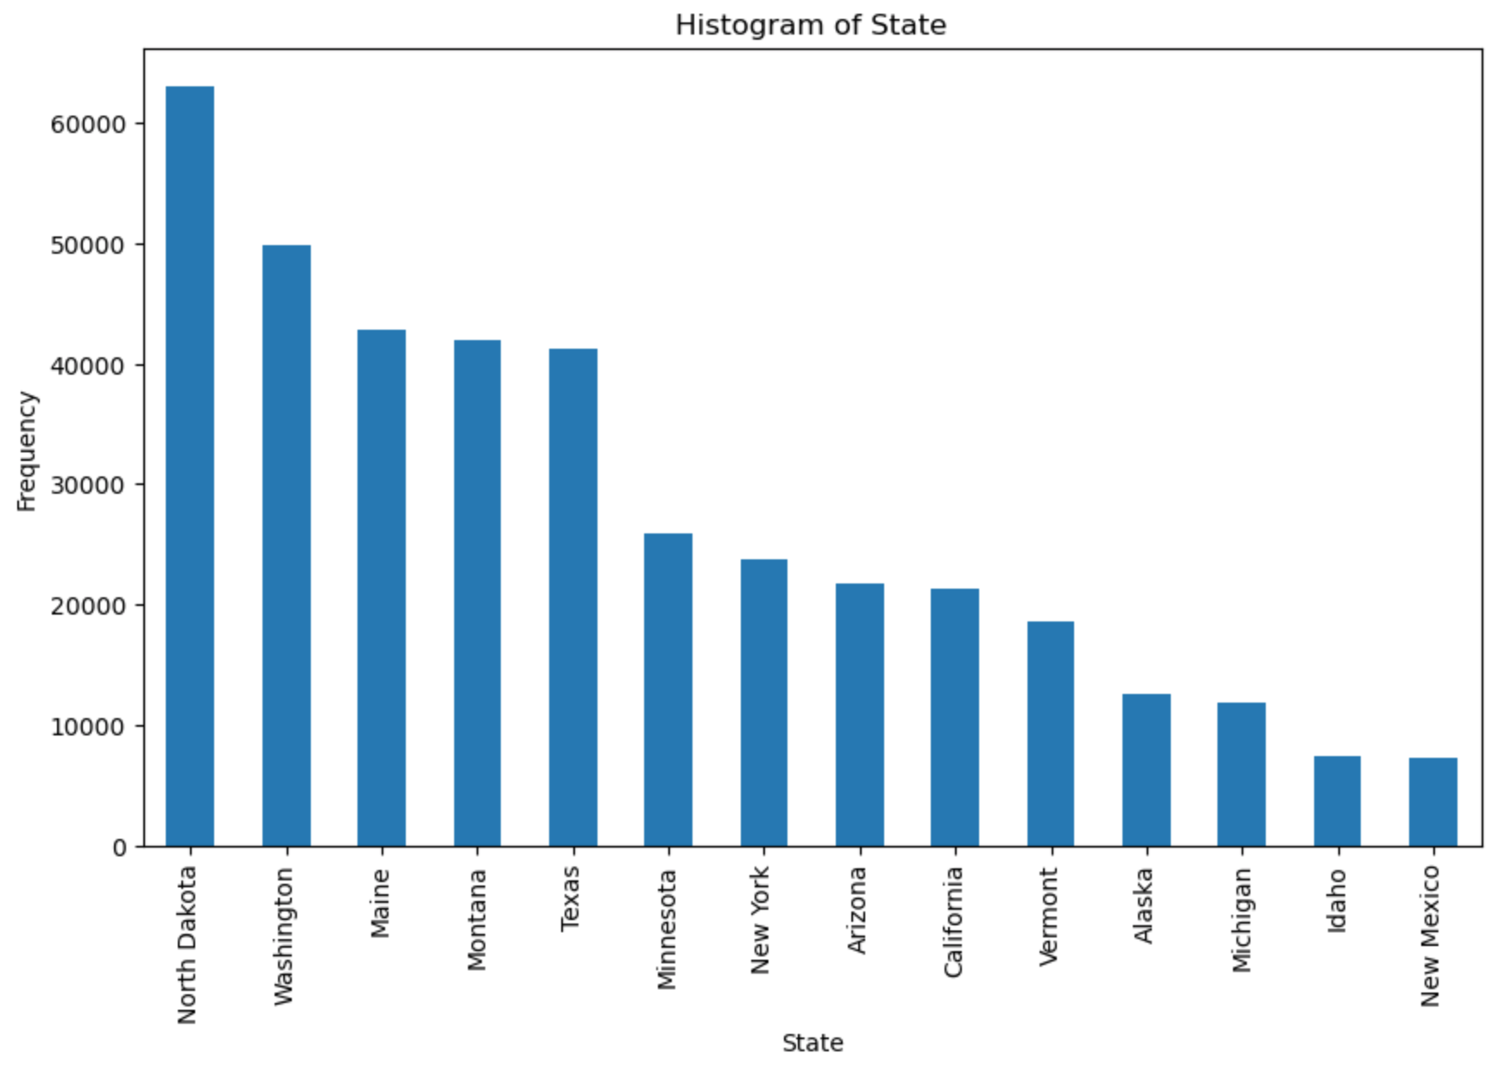
Histogram of State

Slide 7
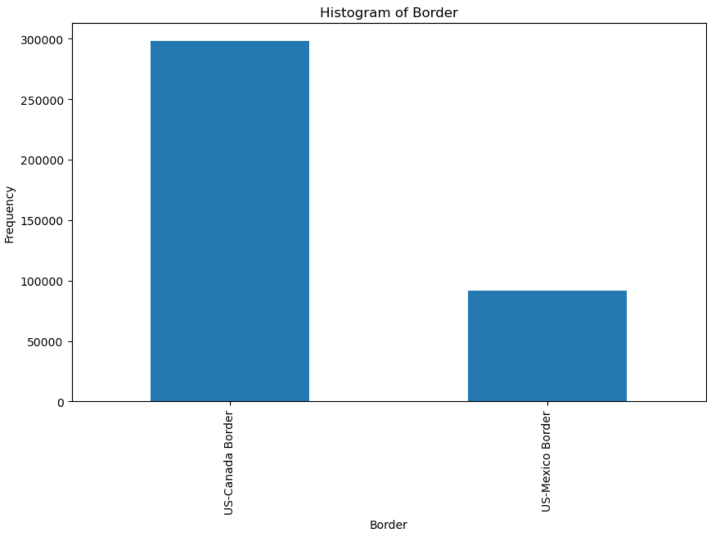
Histogram of Border

Slide 8
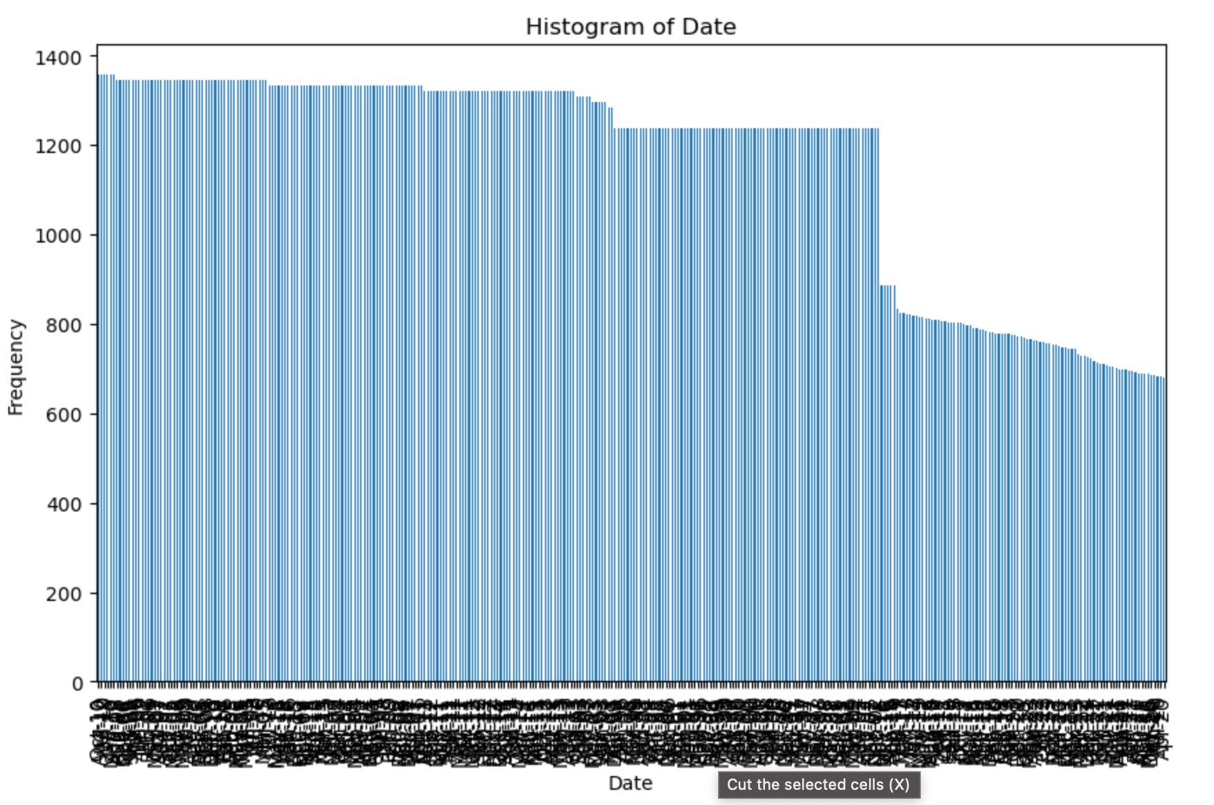
Histogram of Date

Slide 9
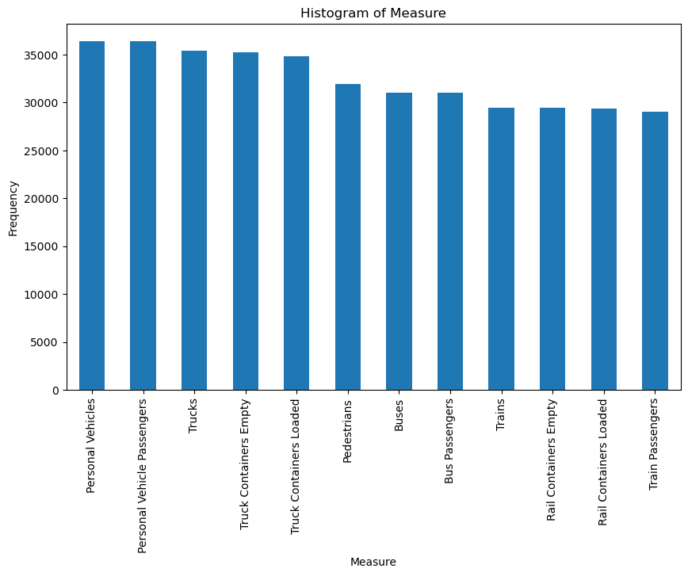
Histogram of Measure

Slide 10
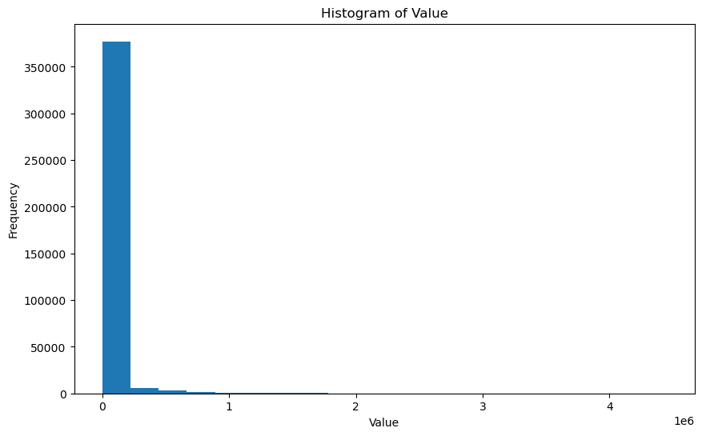
Histogram of Value

Slide 11
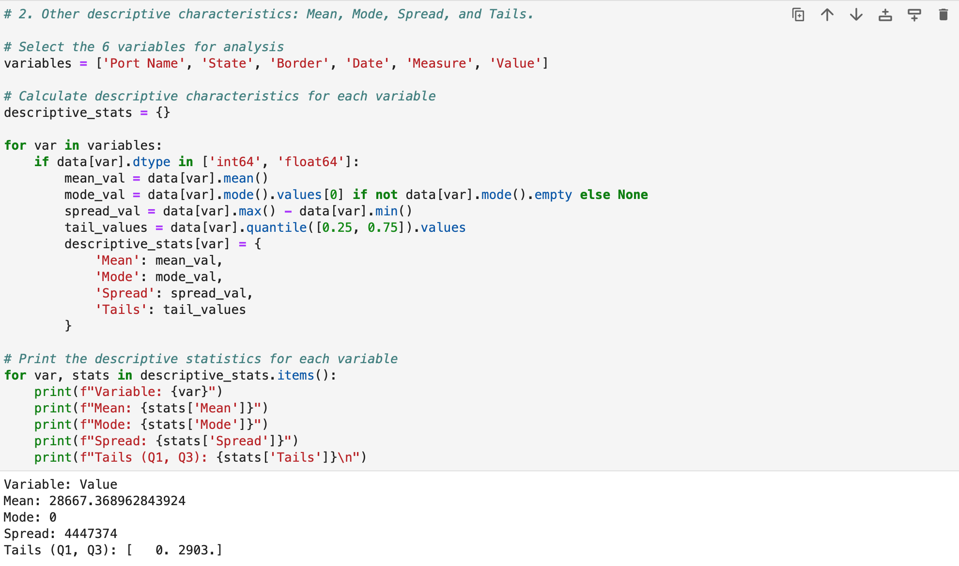
Code to Obtain Descriptive Characteristics of the Variables
Since ‘Value’ is the only numerical variable, it’s the only one I obtained descriptive characteristics from.

Slide 12
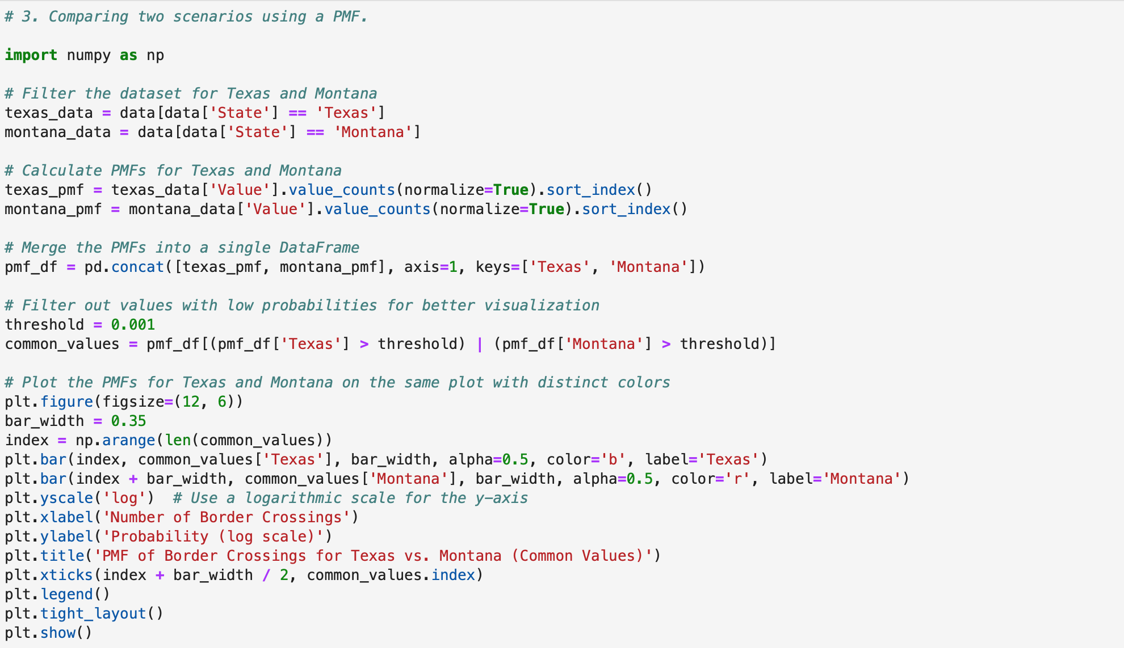
Code to Compare Texas and Montana Using a PMF

Slide 13
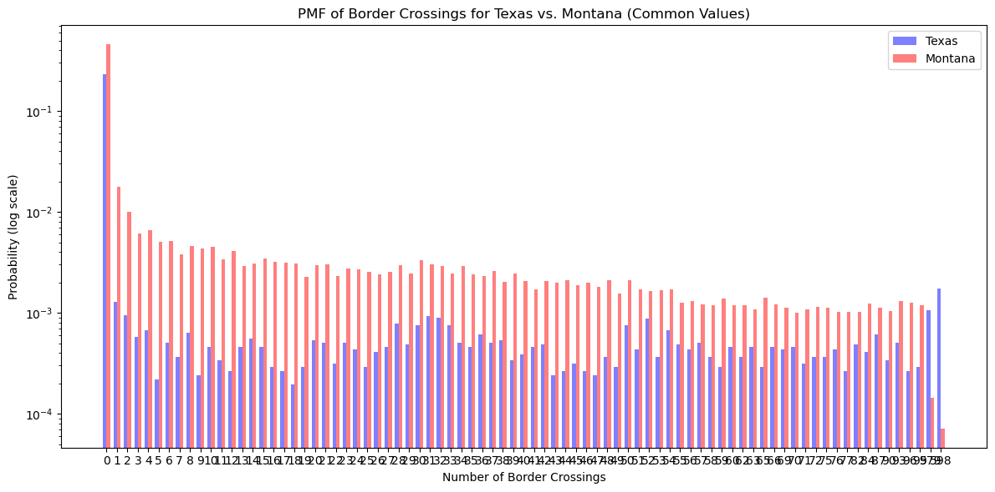
PMF of Border Crossings for Texas vs. Montana

Slide 14
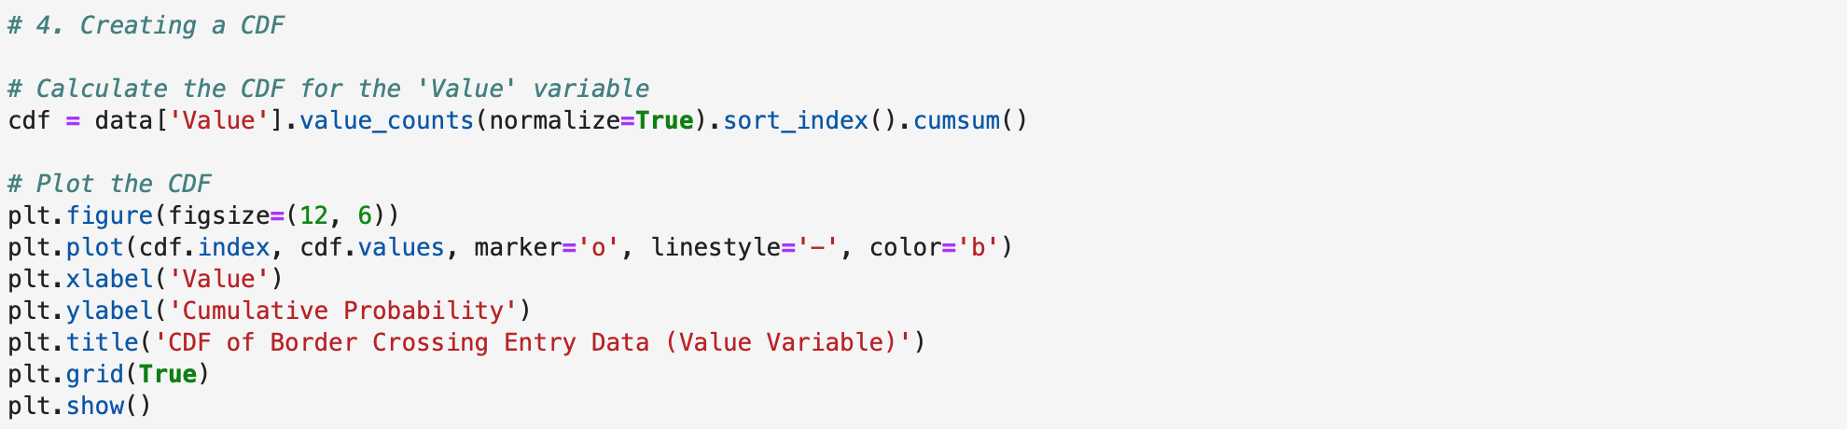
Code to Create CDF for ‘Value’

Slide 15
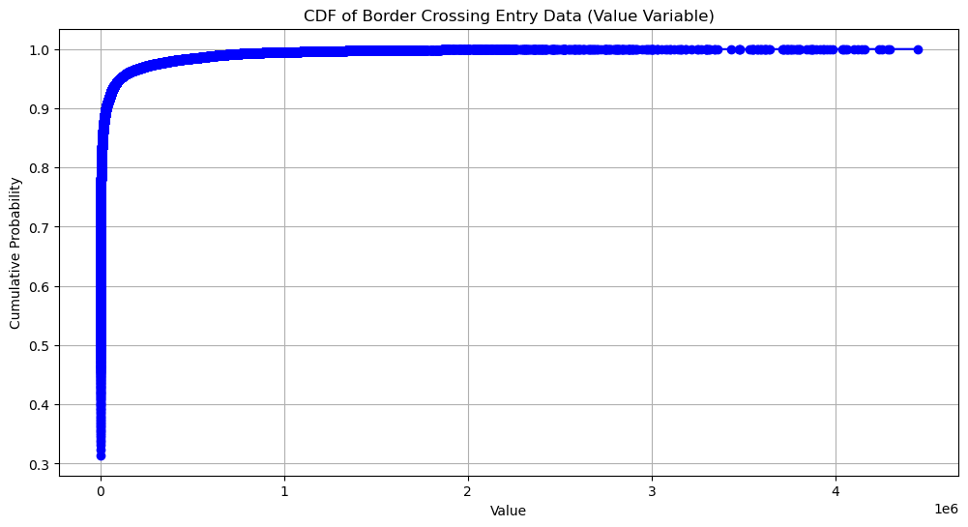
In terms of figuring out if there’s a significant difference in the number of border crossings between different states or borders, this CDF shows us the probability of obtaining a value. It’s clear that between values 1 and 4 on this plot, the probability is the same. In this test, it’s obvious that the ‘State’ data is unaccounted for, but within the range of 1 and 4 we can assume that there will be different data from different states. This means that it’s possible that there could be a significant difference, but we’ll have to continue with the analysis to find out.

Slide 16
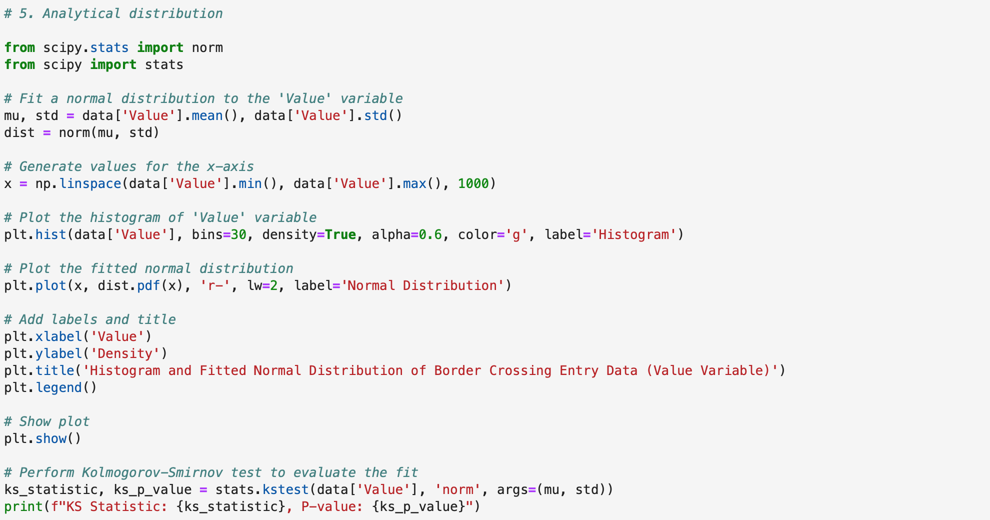
Code to Plot Analytical Distribution

Slide 17
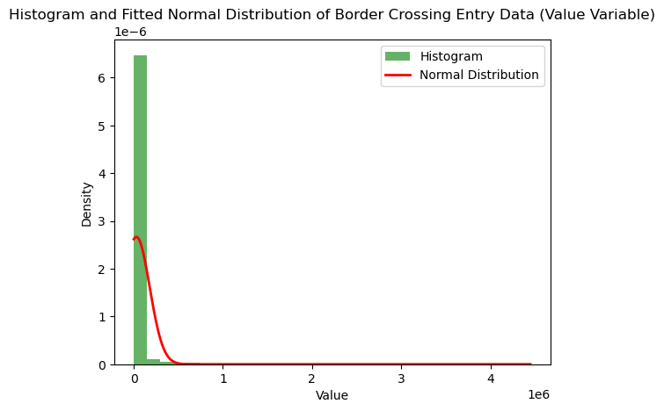
Plotting an analytical distribution, such as a normal distribution, and analyzing its fit to this dataset can provide insights into the underlying distribution of the data. This analysis helps in understanding if the data follows a certain distribution and how well the chosen distribution fits the data. For example, this dataset closely matches the normal distribution, suggesting that the data is normally distributed, which can be useful for further statistical analysis and modeling.

Slide 18
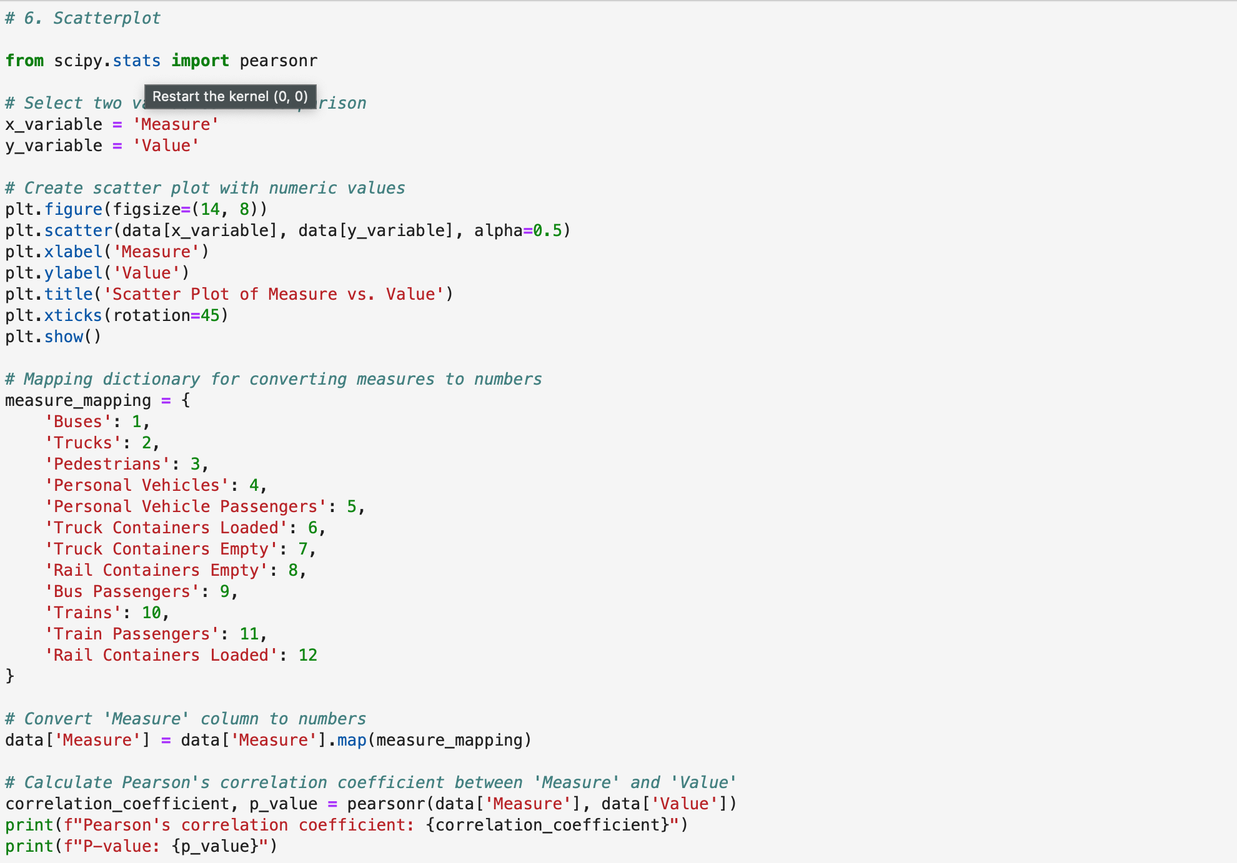
Code to Create Scatterplot

Slide 19
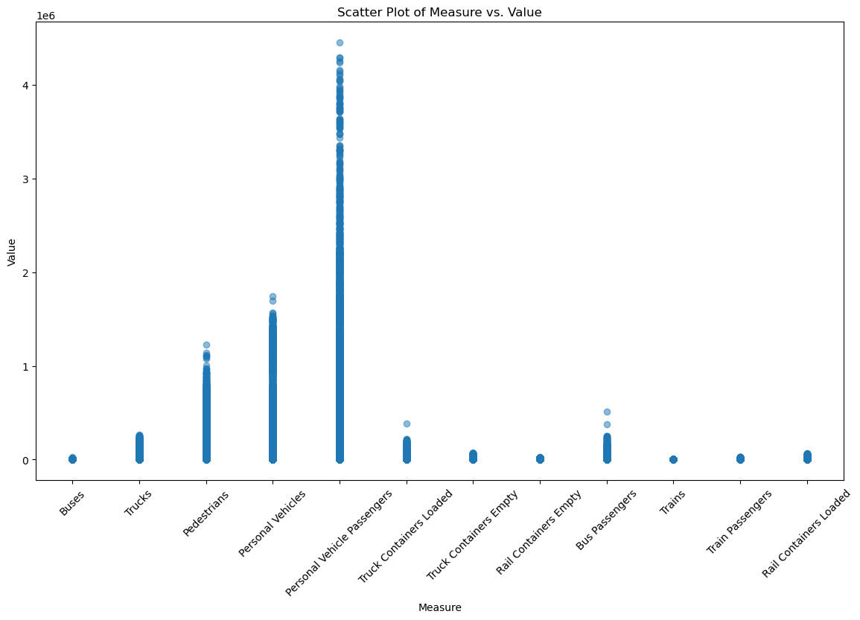
Scatter Plot of Measure vs. Value
It’s extremely difficult to calculate covariance, Pearson’s correlation, etc. because ‘Value’ is the only numerical variable in this dataset.
Pearson’s correlation coefficient: -0.09941751461149709

Slide 20
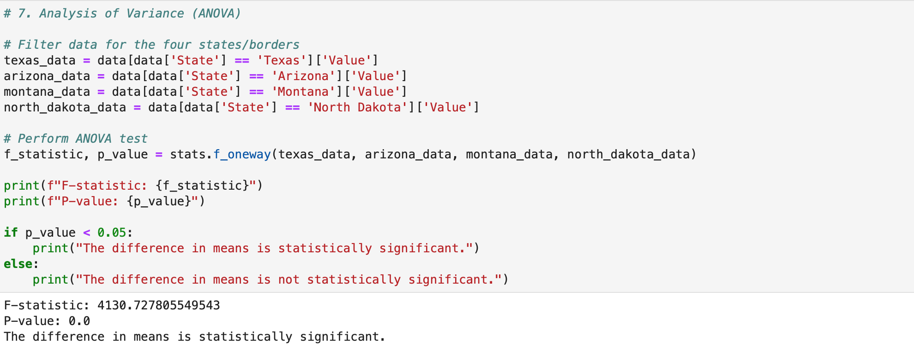
Code to Conduct Analysis of Variance (ANOVA) on Hypothesis
Null Hypothesis (H0): There is no significant difference in the number of border crossings between different states or borders.
A large F-statistic and a p-value of 0 indicate that there is strong evidence to reject the null hypothesis.

Slide 21
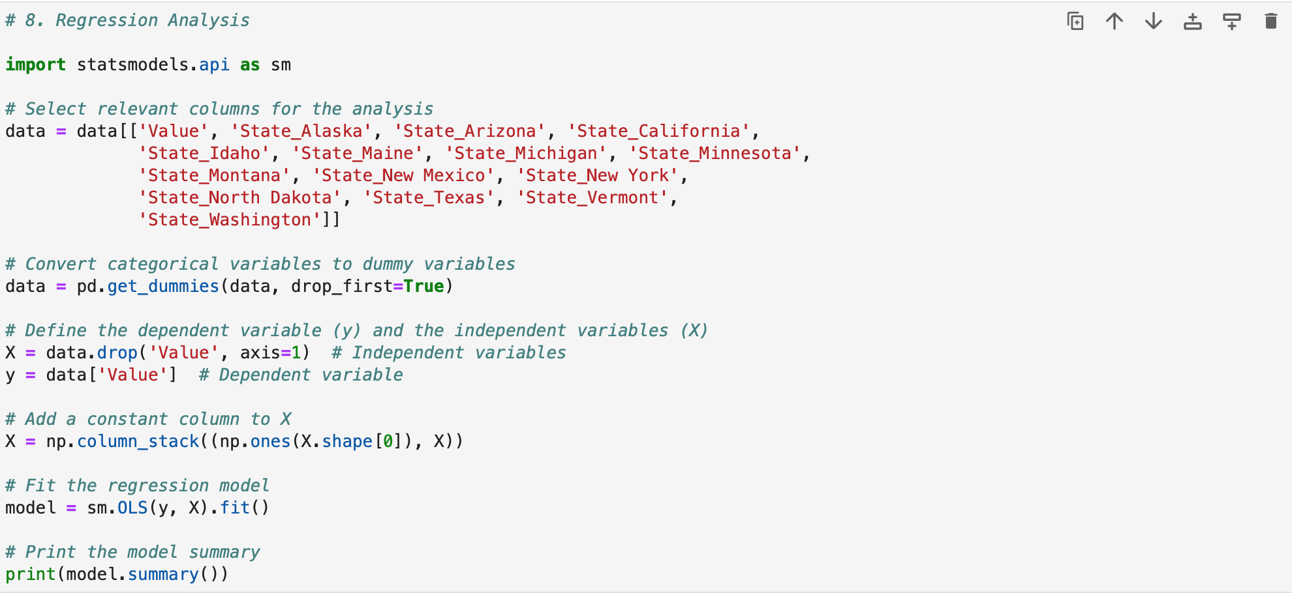
Code to Conduct Regression Analysis between ‘Value’ and ‘State’

Slide 22
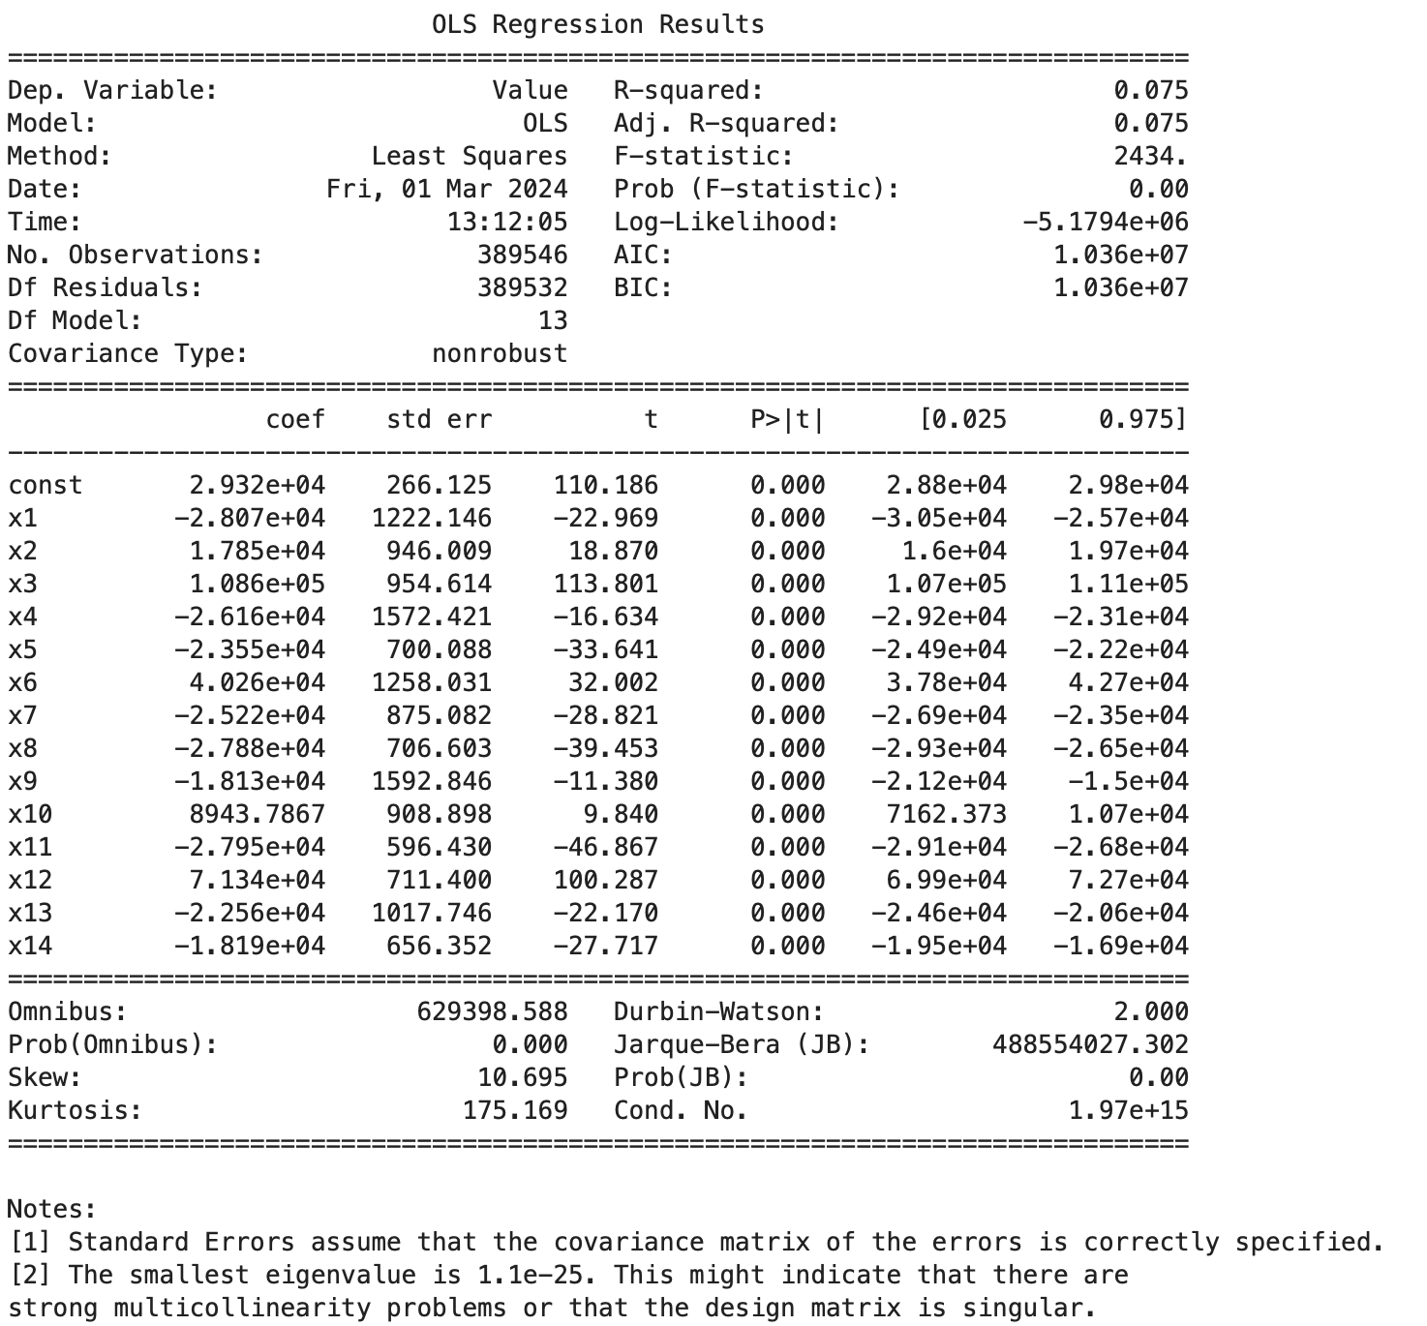
OSL Regression Results

